Slide 1
The Development of different
wheel robot system
Presented By LEE Lok Yin, Edmund
17 November 2020

Slide 2
Content
ELEC3300 Project - 2D Hologram Fan
HKUST Robotics Team - Robocon
CSE Final Year Project - Indoor Guiding System for the Visually Impaired

Slide 3
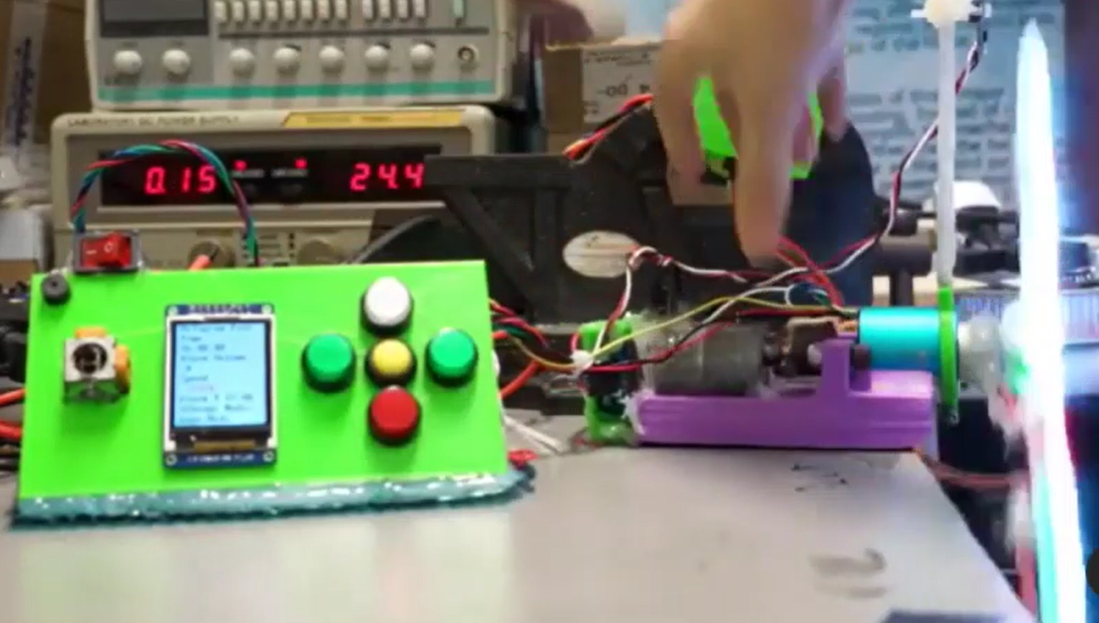
ELEC3300
2D Hologram Fan

Slide 4
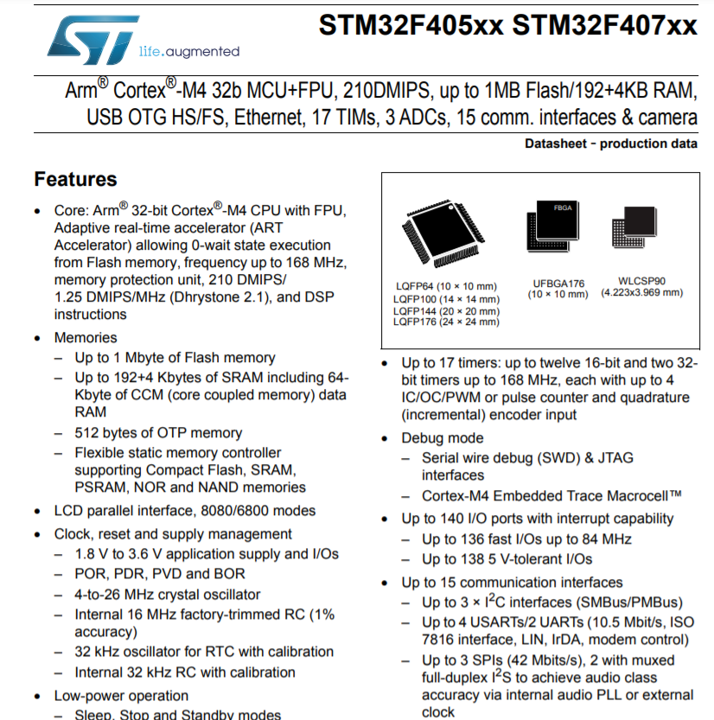
Why?
Data Transmition Speed (Main reason)
20 x 160 pixels 0.96 inch TFT
12Bit RGB
At least 4 TFT is needed
12Hz Display
Sperate to 360 sectors
20*160*12*4*12*360 = 663Mbit/s !!! Even I am using direct memory access(DMA)
Brightness Problem
TFT 500 Nits
LED 4500 Nits

Slide 5
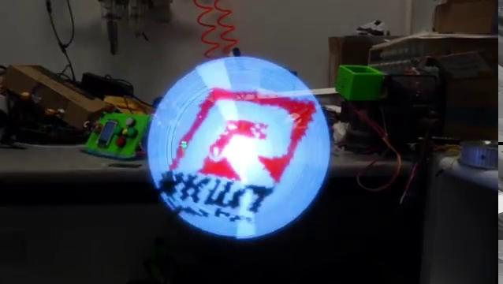

Slide 6
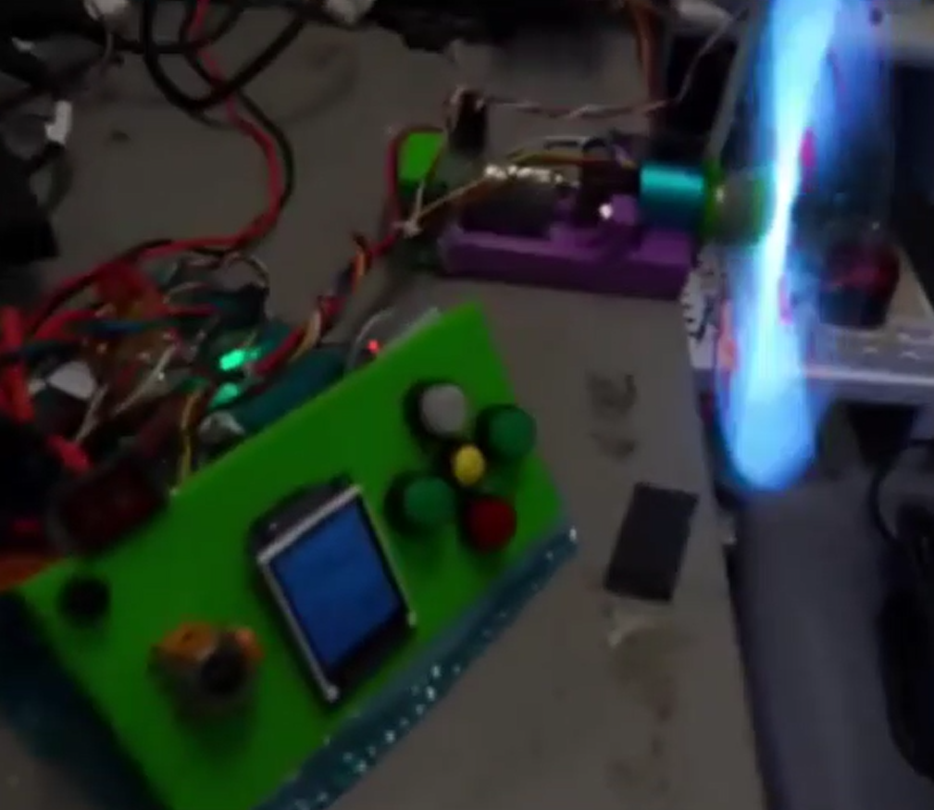
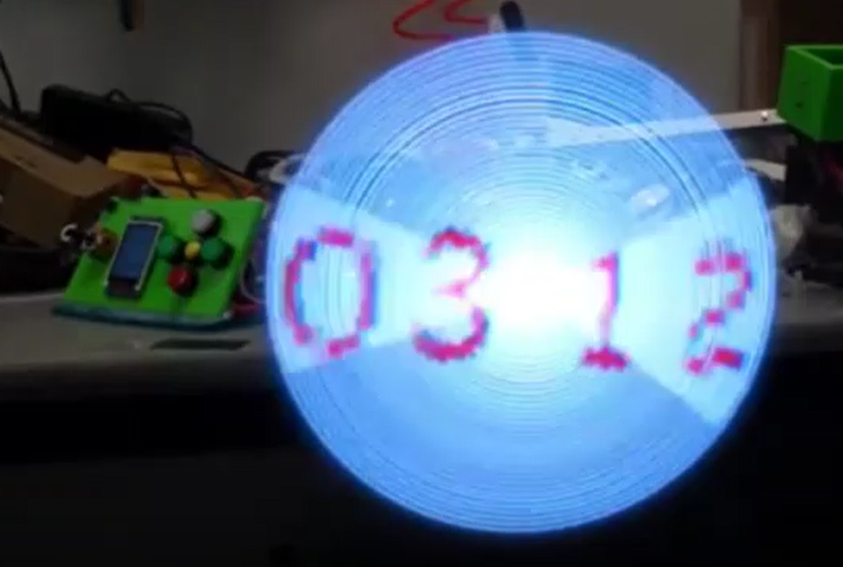
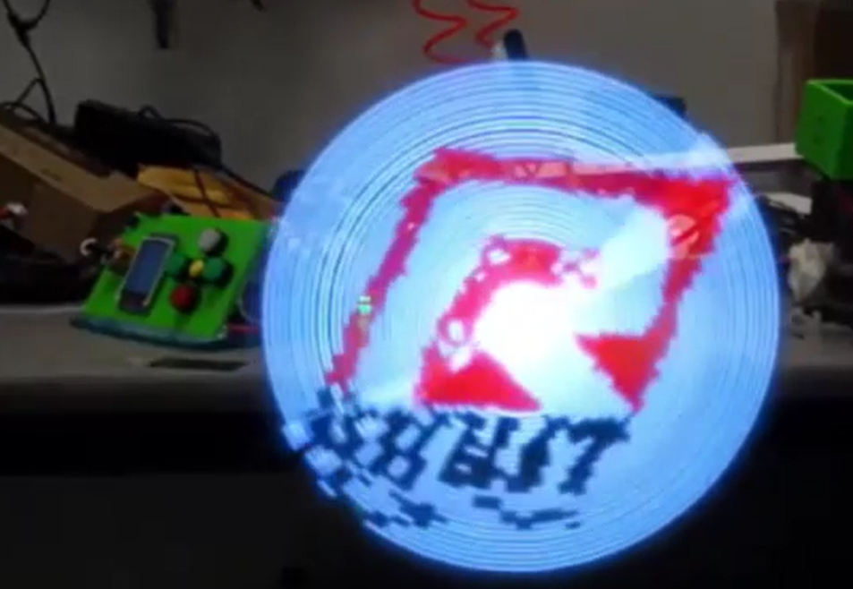
The 2D Hologram Fan
Fan Speed Control
Alarm
Real Time Clock
Logo Display
TFT & Buttons Control

Slide 7
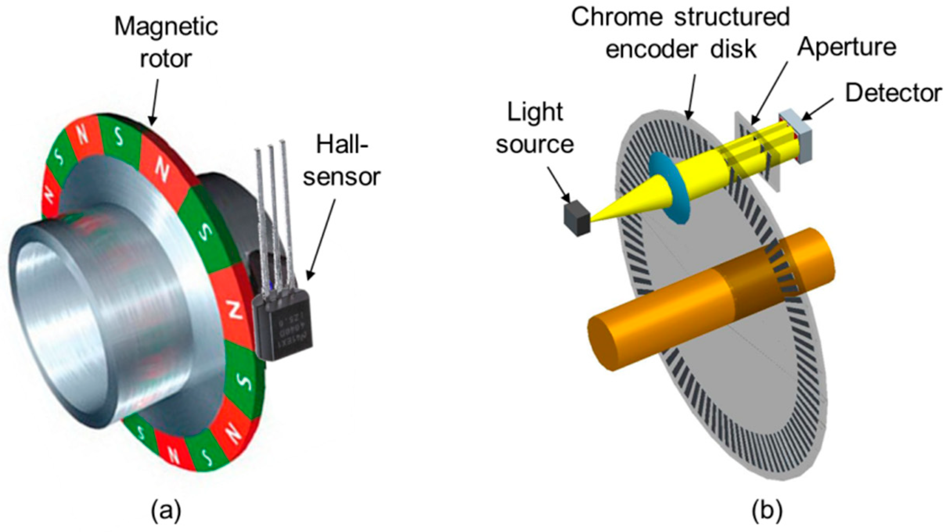
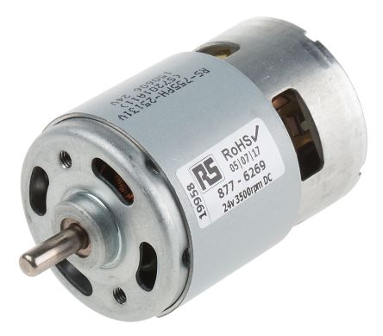
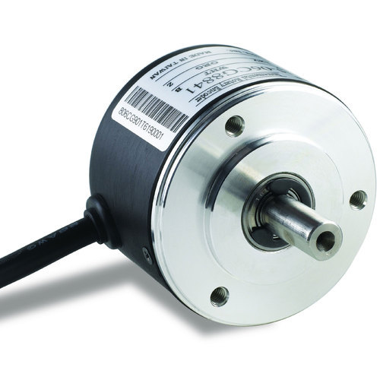
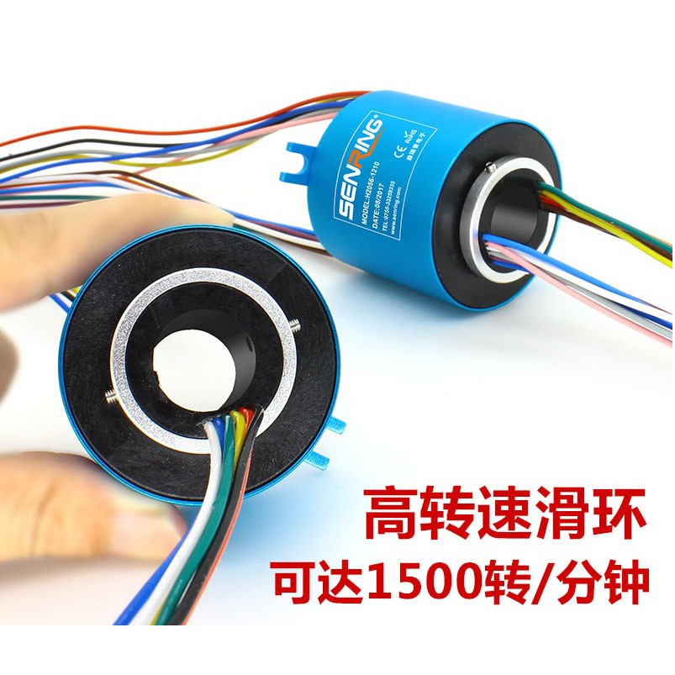
Mechanical Parts
DC Motor
Rotary Encoder
Wire Connection Rotary Joint

Slide 8
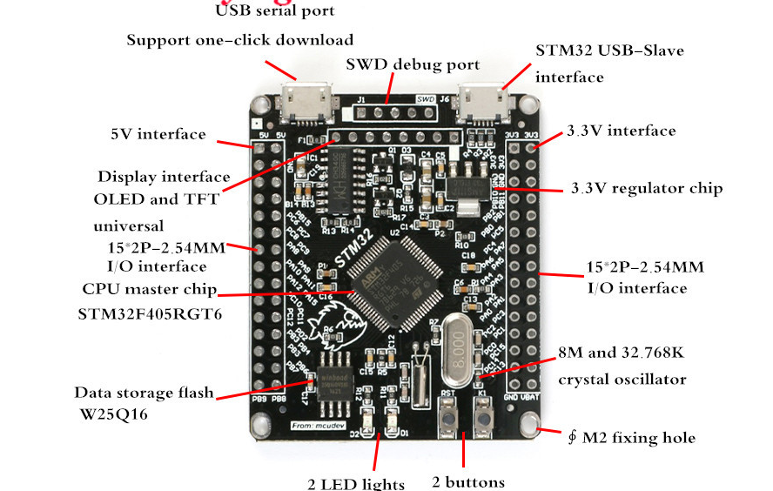
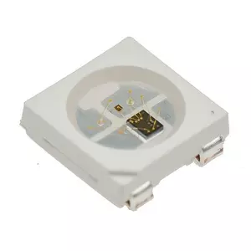
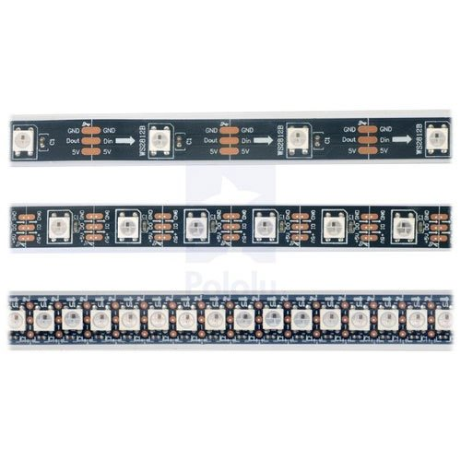
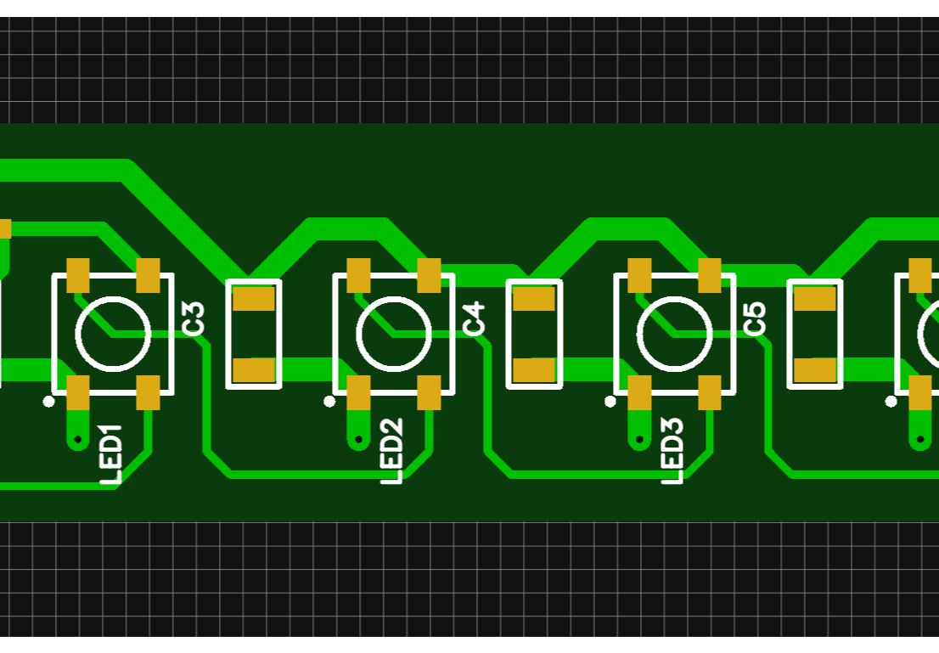
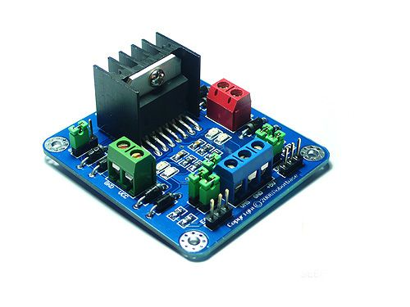
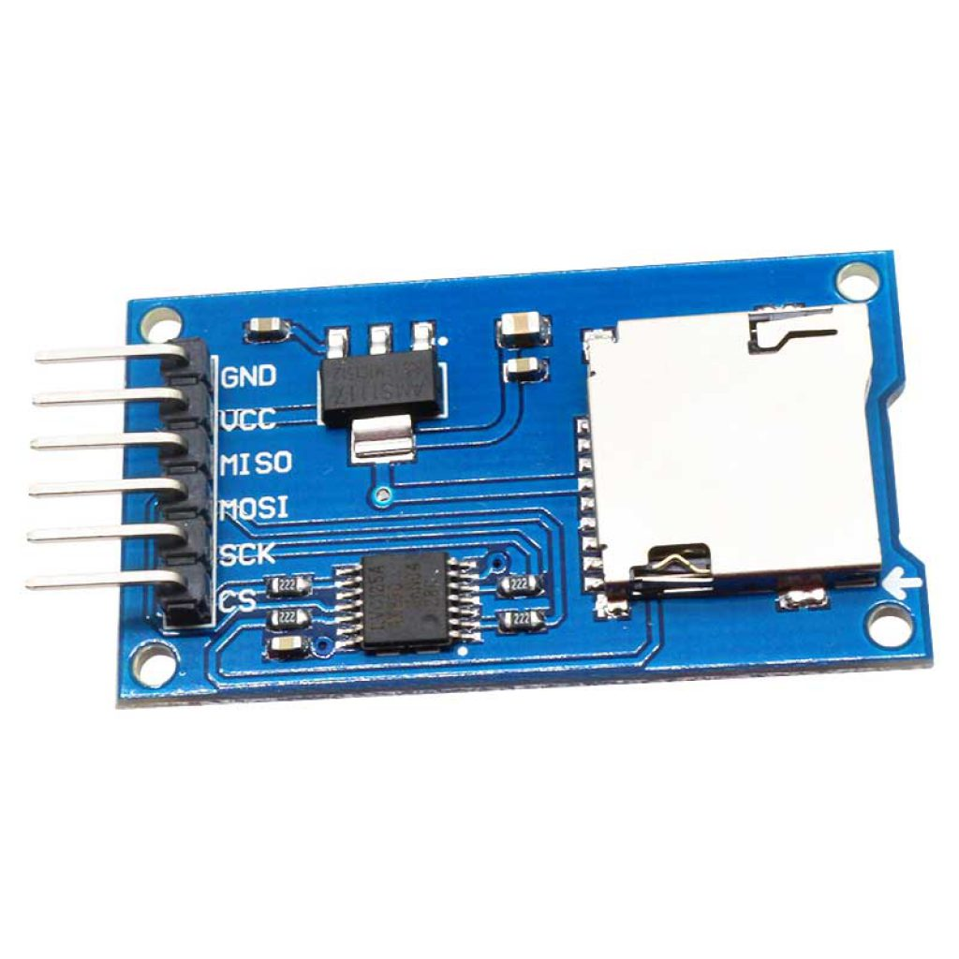
Electronics
STM32F405RGT6
WS2812b LED
Customized PCB
DC Motor Driver
SD Card Reader

Slide 9
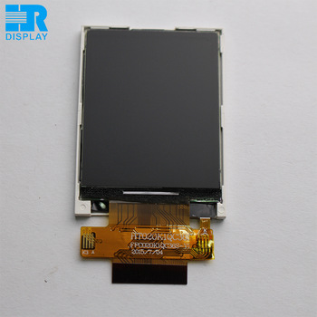
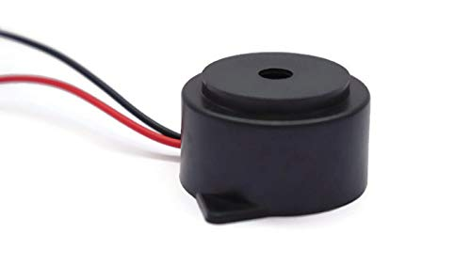
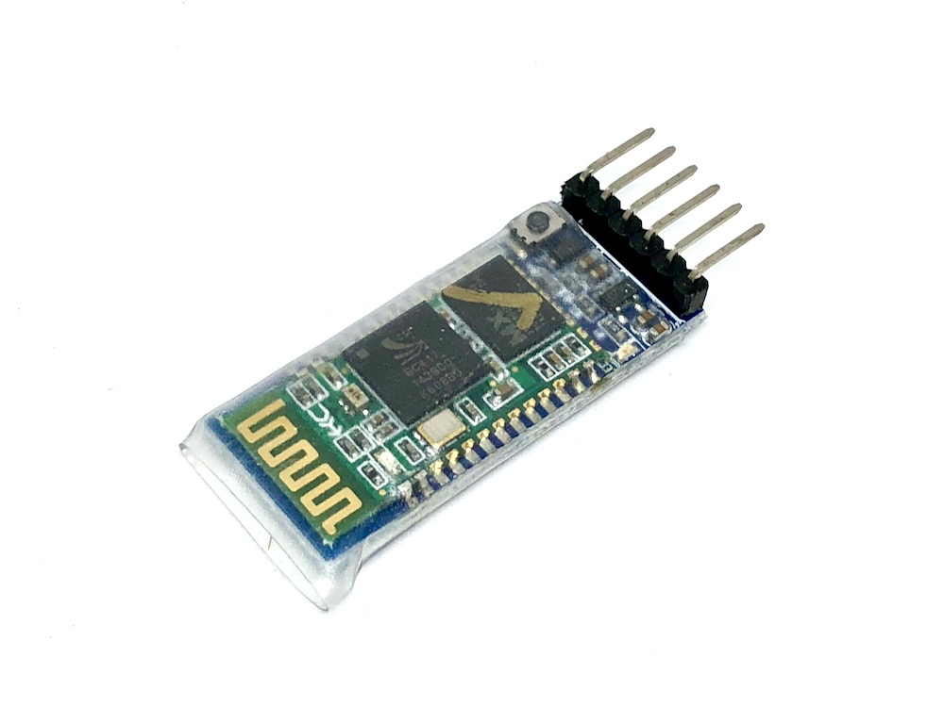

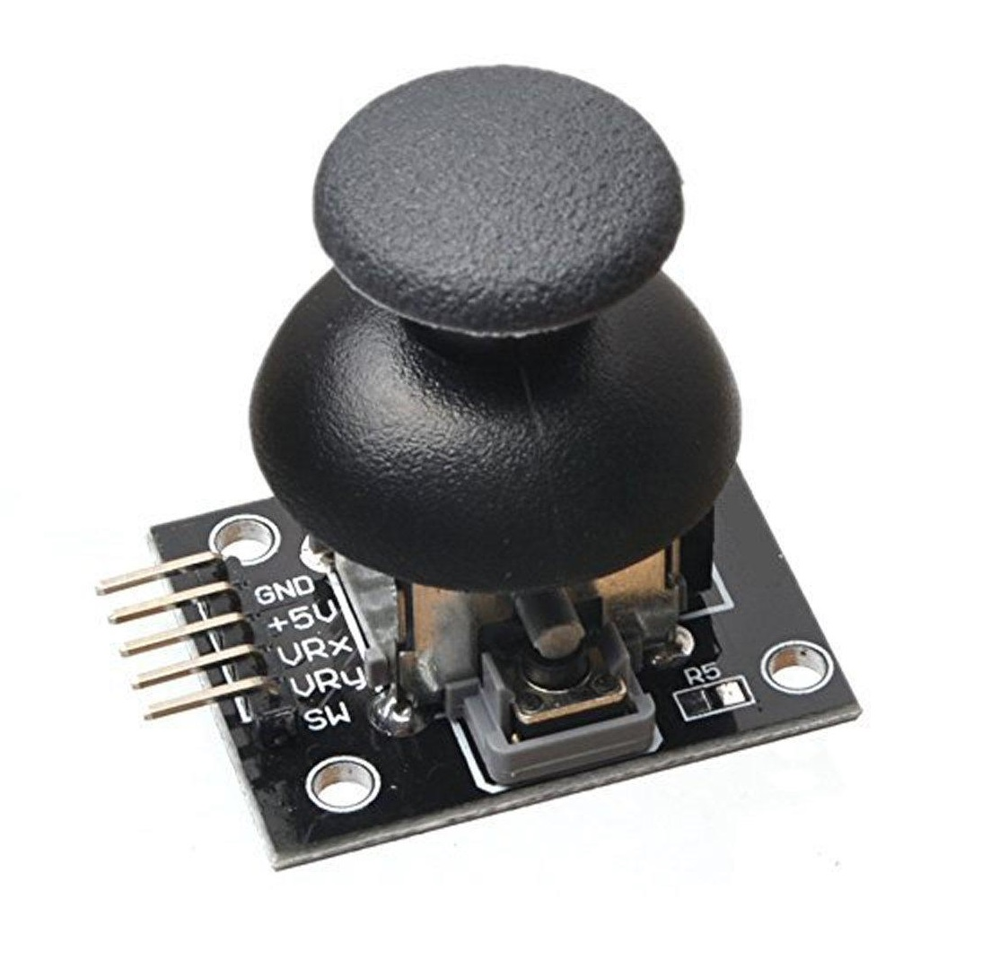
Control UI
2.9 inch TFT
Buzzer
Bluetooth
Buttons
Joystick

Slide 10
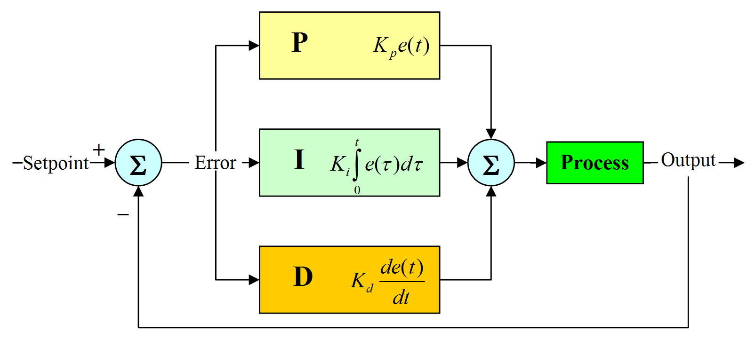
Programming
PID for Fan Speed
PWM as output
Encoder as input
Protocol
SPI for TFT & SD card
GPIO for LEDs & Buttons & Motor & Encoder
UART for Bluetooth
ADC for Joystick

Slide 11

Programming
Display
Image decoding
GPIO Sequence Genaration
Fast switching
R G B
1 1 1 1 0000 0000
1 1 1 1 1 1 1 1 1 1 1 1
0000 0000 0000
1 1 1 1 0000 0000
1 1 1 1 1 1 1 1 1 1 1 1
0000 0000 0000

